Slide 1


Personal Income Tax Calculator for Cryptocurrency Traders
By Itzchak Feldman, Hilary Zhang, Tom Mortlock-Chapman

Slide 2
Project Context
The rise of blockchain technology, powering decentralised currencies known as ‘Cryptocurrencies’ has led to ~1bn people globally owning/investing in some form of it
(Editors Choice, 2022)
The challenge with this global trend is two-fold:
There is a particular concentration on new retail investors and it also;
Is challenging how government and financial agencies treat these investments in a tax context
Recent legislation in Australia has meant profit/loss from crypto investments is captured as a capital gain/loss (CGT) event as opposed to foreign currency gains.
Hence our group decided to create a simple user interface (UI) that allows investors to input their salary, connect their trading accounts where the UI will automatically identify CGT events and pass total taxable income into our tax calculator (based on Australia’s progressive bracket tax structure).

Slide 3
Executive Summary
Project Goals:
Simplify tax calculations for people like our mock investor John (next slide) and the 44% of Australian investors who trade cryptocurrency with an easy-to-use platform.
Mimic software already readily available for equity market traders (Tom used to work for CGT software provider that required a lot of backend data entry - opp for new market!)
Challenge ourselves across multiple modules of course content - Python, Streamlit, Ganache whilst creating a usable and realistic product.
How the project relates to fintech?:
Input: Numerous fintech technologies including Python, Yahoo Finance API’s and Ganache.
Output: Substantial market for decentralised currencies using blockchain technology that will only continue to grow as use cases and legislation is passed - which will necessitate greater accessibility to personal trade and tax management platforms.

Slide 4

Mock Investor Situation
“John has two income streams: he earns a $150k p.a. salary as a software engineer at Optiver, and earns income executing hundreds of ethereum trades each financial year. John wants to find a straightforward tool to find out his personal income tax based on Australian Taxation Regulations”
Our Solution:
A simple UI that allows John to input his salary, and connect his ethereum trading wallet from Ganache.
The UI will then calculate his assessable net capital gains from trading (assuming all losses are used to offset gains this FY) thus calculating his total assessable income including his salary and gains, and deliver his Net Income, Tax Paid and Effective Tax Rate.

Slide 5




Technical - Project Frameworks
Coding - Python/Pandas
UI - Streamlit
Blockchain - Ganache (ETH)
MetaMask
API - yfinance

Slide 6
Build Process and Code Evaluation
We had challenges to evaluate our code using multiple run times and multiple modules:
We started by exporting a common CSV and working with Jupyter Notebooks
The next phase was to integrate it with actual blockchain data, simulating Ethereum network using Ganesh
Then we had to convert our .ipynb files to .py files
We had to rewrite the code in functions, receiving and returning dataframes
We broke down the code to several helper functions
Finally we integrated everything into a streamlit app

Slide 7
Challenges during project
Getting transactions for ETH account:
This is a new method we used that was not taught in class
We had to iterate through all the blocks of the blockchain
For every block we looped through the transactions and looked for the account ID either in the sender or receiver field
Transaction date was taken from the block
Data structure worked on python notebook, but not on streamlit
We identified differences in data frames created from CSVs or retrieved directly from the blockchain
Never change a CSV file with excel!

Slide 8
Challenges during project - Loops Approach
Generating daily portfolio view from transactions
Requires generation of days with no transactions - value changes on these dates as well
The calculation logic combines 3 different data frames: Portfolio holdings, transactions, and daily portfolio value
Calculating capital gains
We split buy and sells
For every sell we had to find the relevant buy (FIFO)
We had 3 scenarios:
Sell transaction = Buy transaction → easy match!
Sell transaction < Buy transaction → just part of the buy transaction will be attributed to this sell, and the rest will go to the next sell
Sell transaction > Buy transaction → Find enough buy transactions to cover the sale amount
Lastly we calculate the tax according to the annual income based on tax brackets

Slide 9
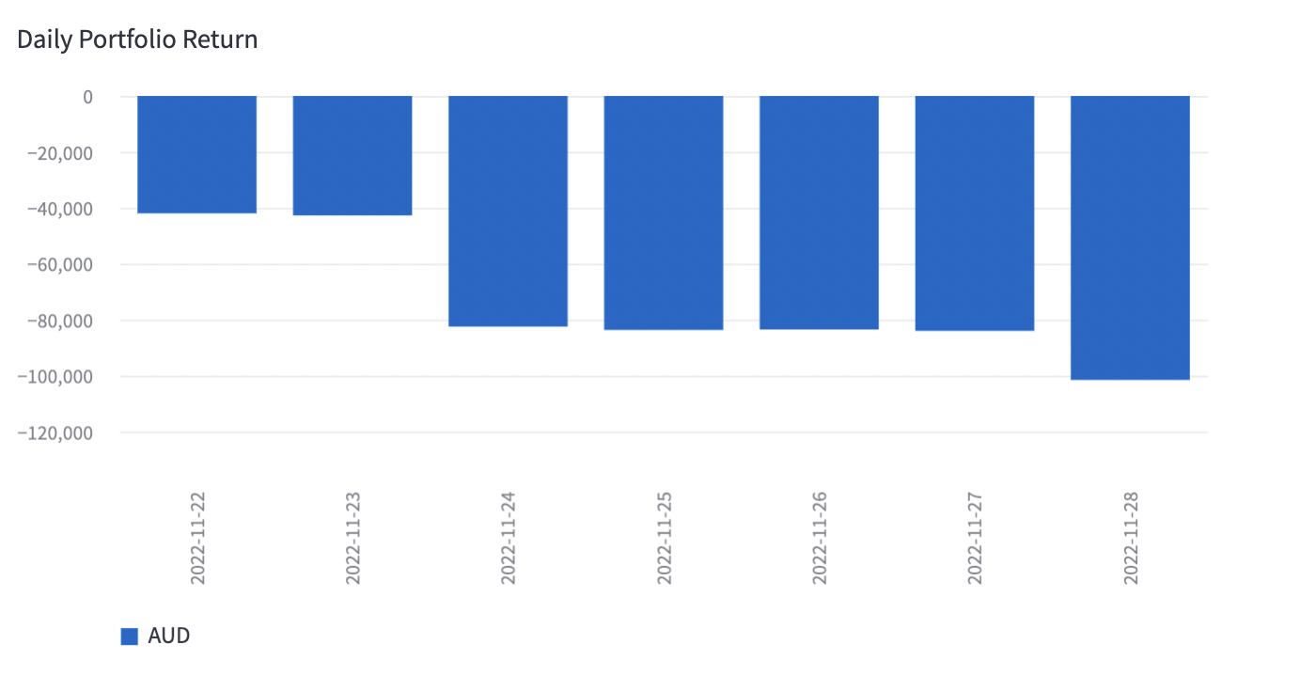
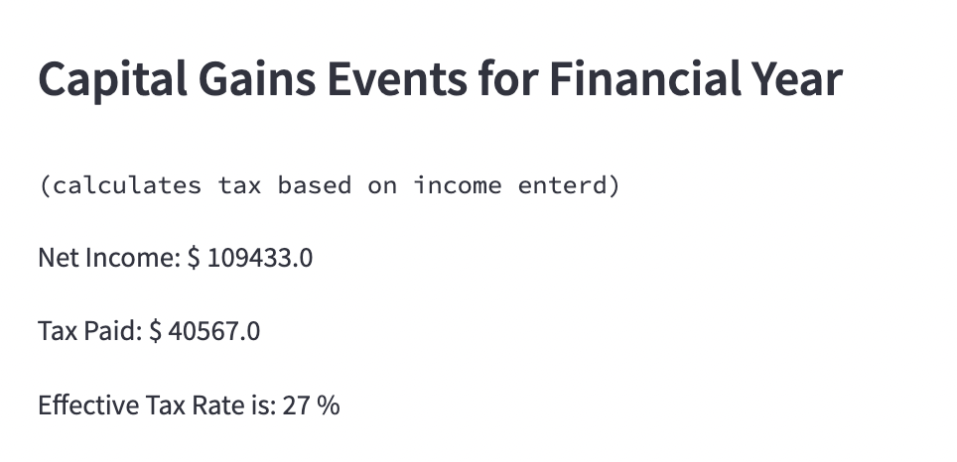
Demo - John’s Total Income (Salary + Capital Gains) Tax
Input salary: $ 150,000 p.a
Input John’s account address: 0xFFc60B8ED29034b9c71Bdd82AA5dd4d9e9903b27
Results:
(From inputting John’s account and running streamlit web page)

Slide 10
Potential Next Steps
Split tax between income streams
Add support for more currencies (not just ETH)
Add support for more countries (not just AUD and Australian tax brackets)
Support Ethereum accounts from the mainnet and not Ganesh
Support multiple tax years (currently only one year is supported)

Slide 11
Appendix 1: Capital Gains Tax
Capital Gain Tax (CGT) is the tax charged on profits derived from assets bought and sold on various markets, such as stocks, property and of course cryptocurrencies.
General rules:
Tax is only applicable to gains but capital losses can be used to offset gains.
Net capital gains are included with income and charged as a total at progressive rates in Australia
If the asset is held for more than 12 months, you are entitled to 50 % tax deduction on your capital gains.
For more information, visit: https://www.ato.gov.au/Individuals/Capital-gains-tax/

Slide 12
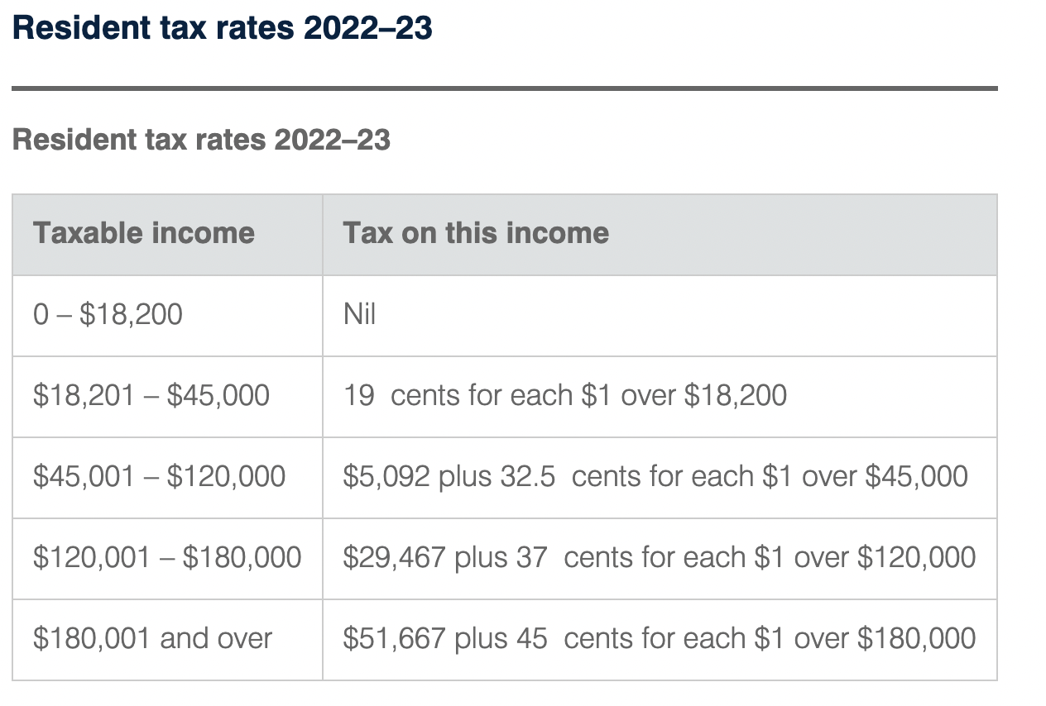
Appendix 2: Demo on how to calculate CGT
Scenario: Your full-time job income is $65,000 and you crypto income is $5,000. Together, your personal income is $70,000. This fitts you in the $45,001 - $120,000 bracket. Your CGT is:
Tax for 2022-23:
5092 + (70,000 - 45,000) * 0.325 = $ 13,217
Tax rate:
$ 13,217 / $ 70,000 = 18.9 %.
18.9 % is your crypto income tax rate.
Note: The above assumes that there is no tax deductible items. Each person may subject to different conditions. For more about individual income tax rate:https://www.ato.gov.au/rates/individual-income-tax-rates/
(Individual income tax rates, ATO, 2022)

